Slide 1
Employee Absenteeism Clustering
MINI PROJECT-1

Slide 2
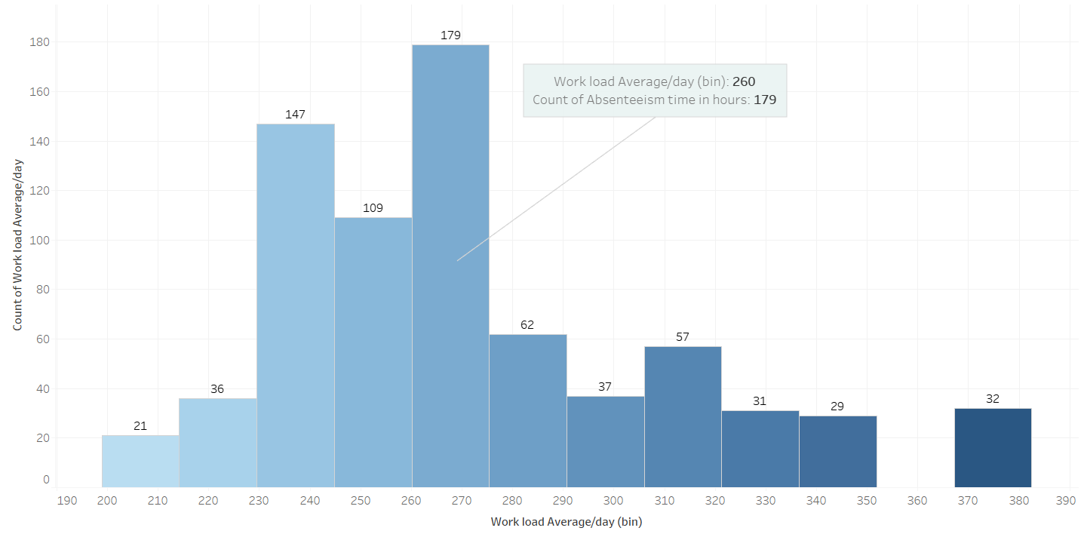
Workload wise Absenteeism Hours

Slide 3
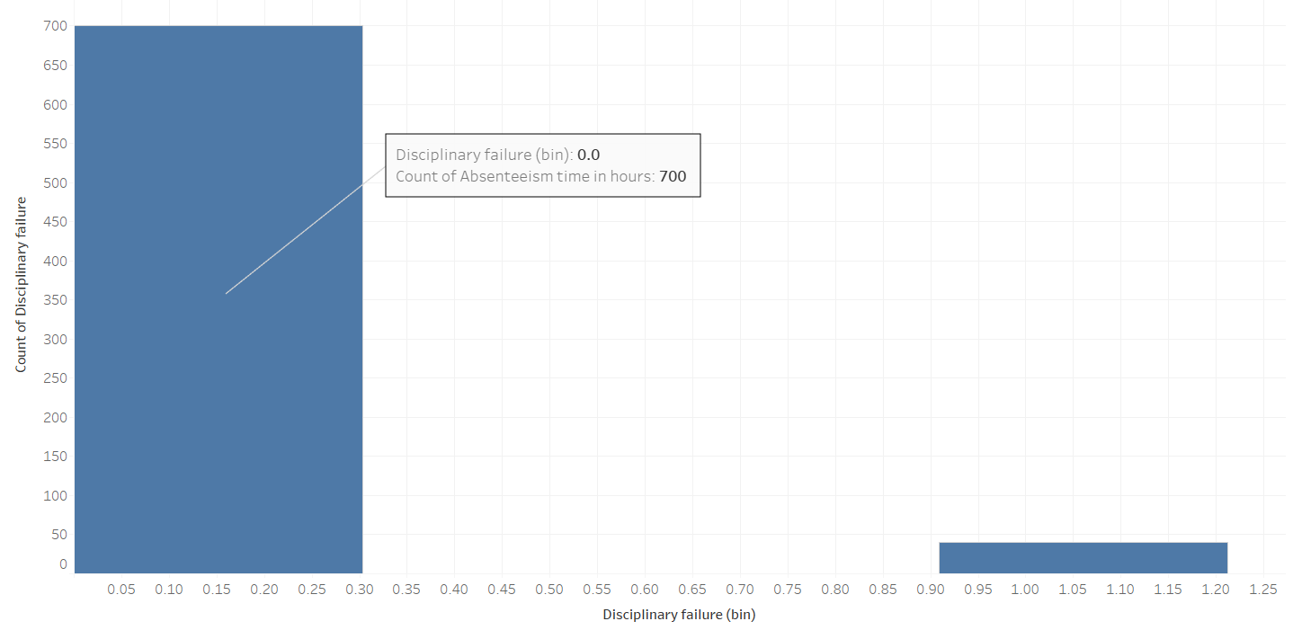
Disciplinary failure wise Absenteeism hours

Slide 4
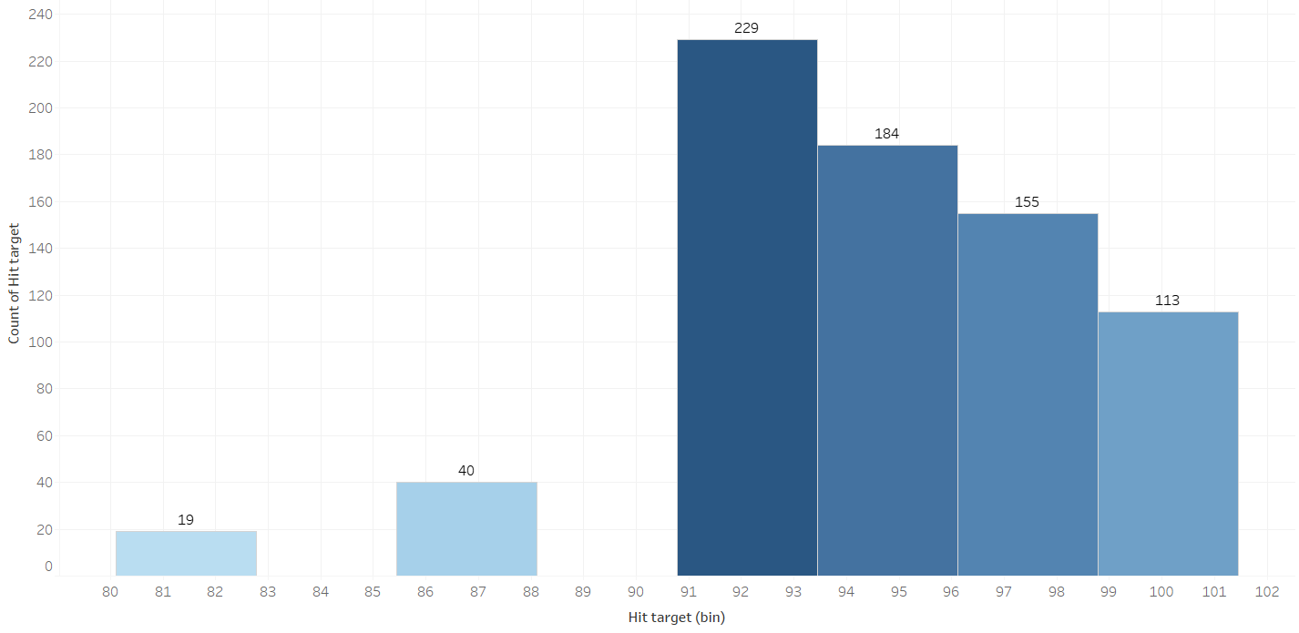
Hit Target wise Absenteeism Hours

Slide 5
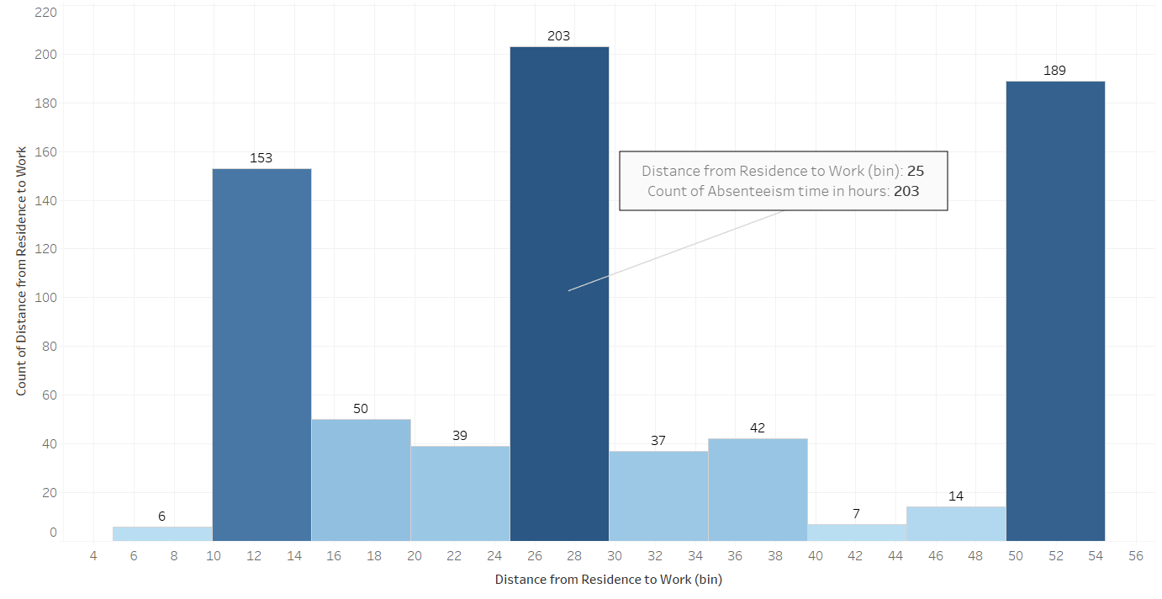
Distance wise Absenteeism Hours

Slide 6
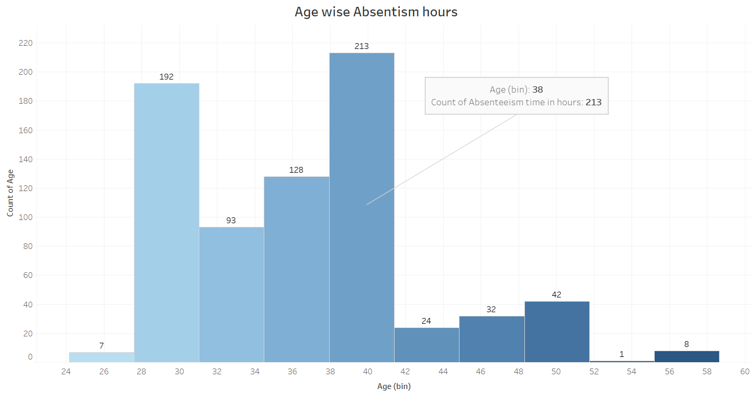
Age wise Absenteeism Hours

Slide 7
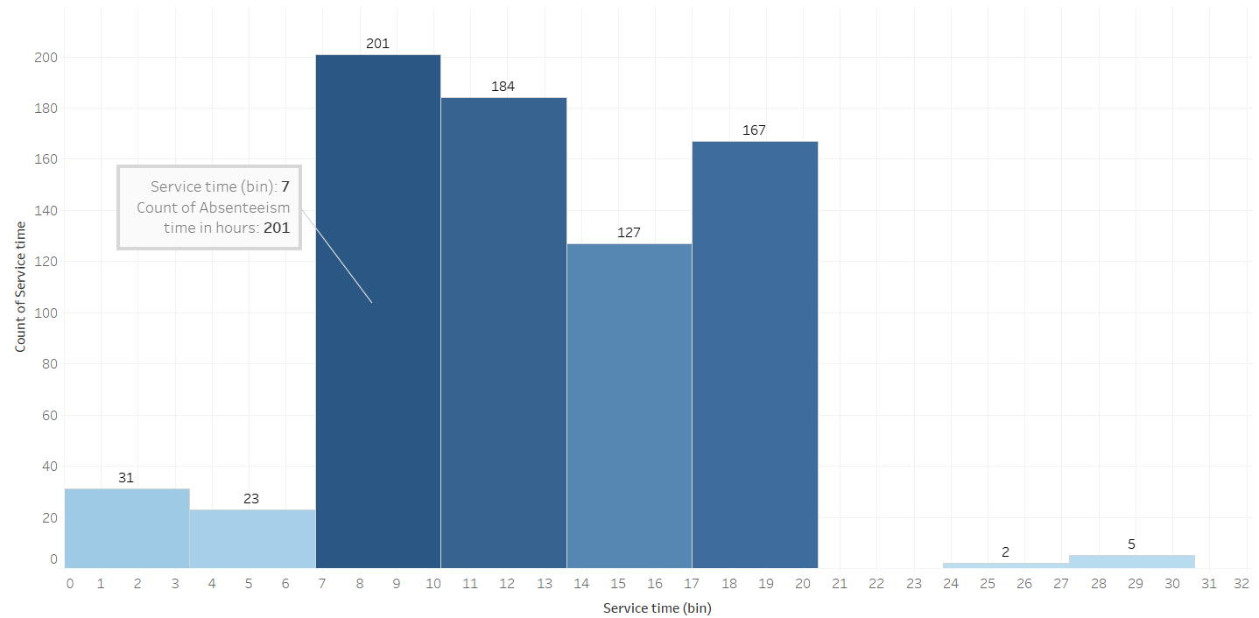
Service Time vs Absenteeism Hours

Slide 8
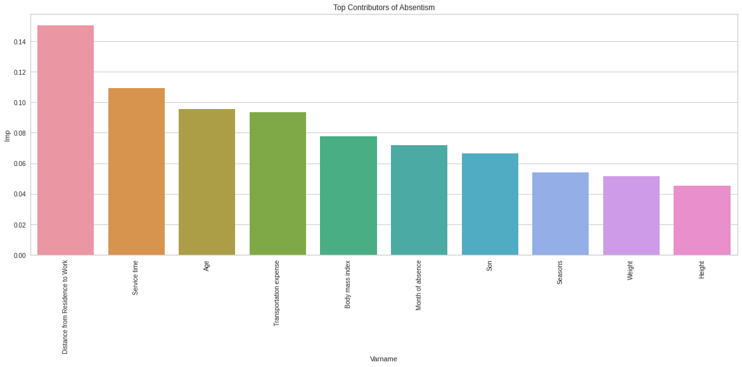
Business Scenario
Best algorithm is Agglomerative Clustering PCA Algorithm, Score is 0.31
Top Five Contributors For the Absenteeism of Employees as listed below:
Distance from Residence to work
Service time
Age
Transportation Expense
Body Mass Index

Slide 9


